Slide 1
OOPS
Call By Value & Call By Reference
Static Keyword
Static Variable
Static Block
Static Method
Static Nested Class

Slide 2
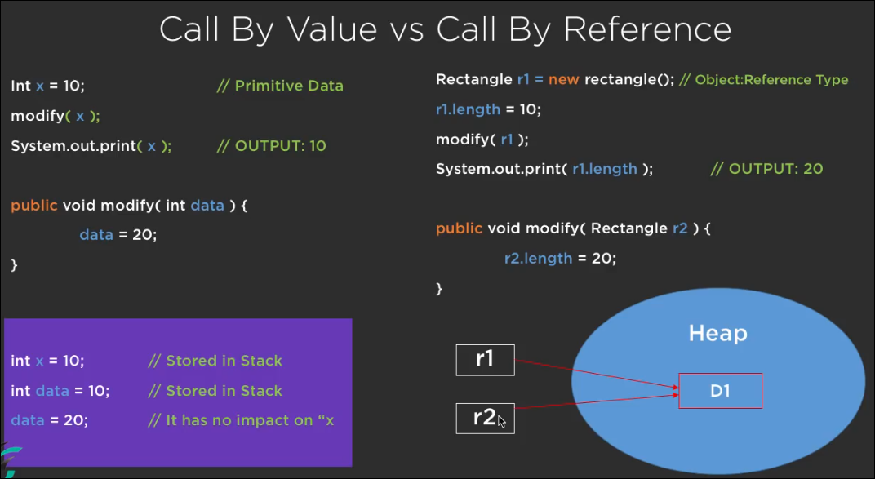

Slide 3
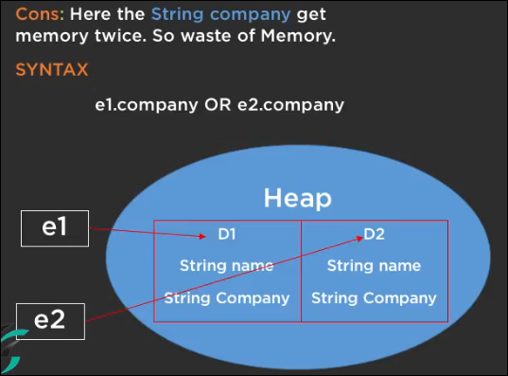
Non Static Variable
class Employee{
String name;
String company=“Ecom”
}
Employee e1=newEmployee() // D1
Employee e2=newEmployee() // D2

Slide 4
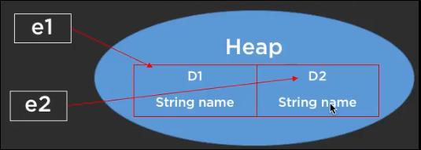
Static variable
class Employee{
String name;
static String company=“Ecom”
}
Employee e1=newEmployee() // D1
Employee e2=newEmployee() // D2
Here company is common for the
D1 & D2 . It will allocate in class area
When jvm loads the class. It is not
associated with the object, it is associated
with the class only
String company =“Ecom”

Slide 5
Accessing Non static and Static variable
Here the String company get memory twise.
So waste of memory
Syntax :
e1.company
OR
e2.company
Here the String company get memory only once.
So memory Efficient
Syntax:
Employee.company

Slide 6
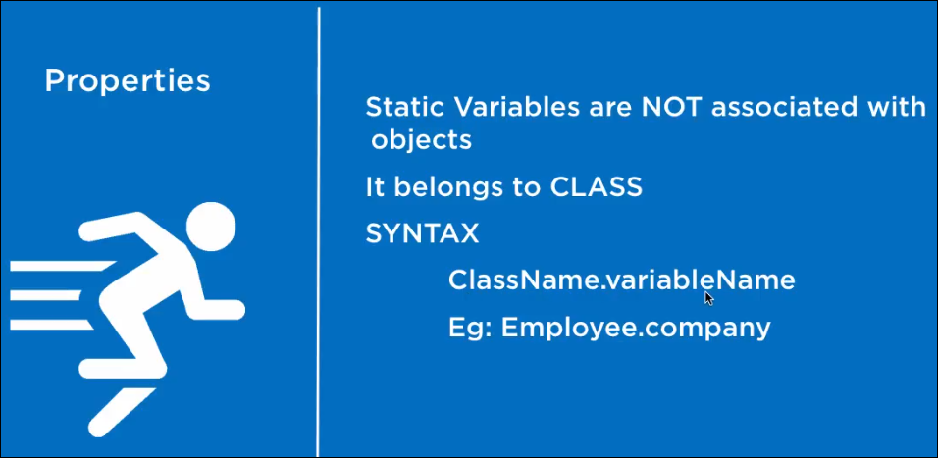

Slide 7
STATIC VARIABLE
Declare a variable as static -- A single copy of the variable is created and divided among all objects at the class level.
STATIC METHODS
A method is declared with the static keyword
Example : main( ) method.
They can directly call other static methods only.
They can access static data directly.

Slide 8
STATIC CLASS
A class can be made static only if it is a nested class. Nested static class doesn’t need a reference of Outer class.
A static class cannot access non-static members of the Outer class.
STATIC BLOCKS
Used for static initializations of a class.
Code inside static block is executed only once: the first time the class is loaded into memory.

Slide 9
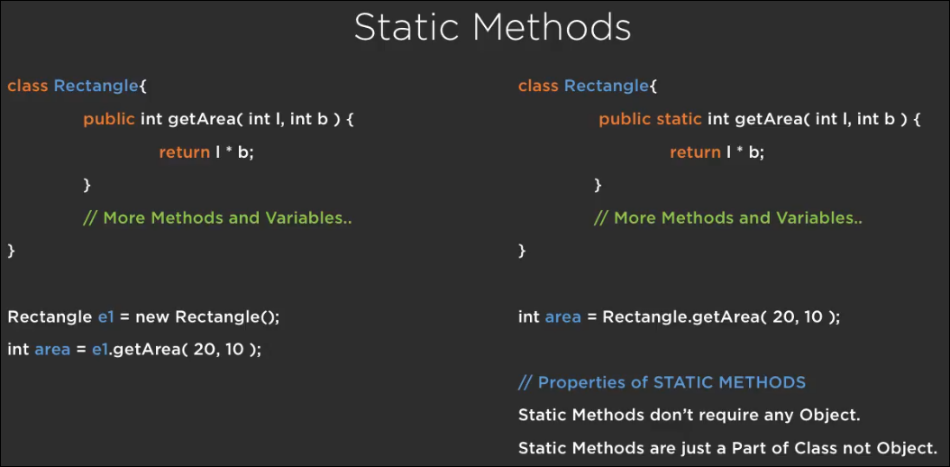
1QSQQQ

Slide 10
